Slide 1
Colonial Coal International Corp.
TSX-V: CAD
Western Canada’s Leading Coking Coal Developer
2025 July Investor Presentation

Slide 2
Legal Disclaimers
This presentation may contain forward-looking statements, and forward-looking information under applicable securities laws including management’s expectations of future production, cash flow, and earnings. These statements are based on current expectations that involve a number of risks and uncertainties, which could cause actual results to differ from those anticipated. These risks and uncertainties include, but are not limited to: the risks associated with the commodity industry (e.g. operational risks in development, exploration and production; delays or changes in plans with respect to exploration or development projects or capital expenditures; the uncertainty of reserve estimates; the uncertainty of estimates and projections relating to production, costs and expenses, and health, safety and environmental risks), commodity price, price and exchange rate fluctuation and uncertainties resulting from potential delays or changes in plans with respect to exploration or development projects or capital expenditures.
There can be no assurance that forward-looking statements will prove to be accurate, as actual results and future events could differ materially from those anticipated in such statements. Colonial Coal undertakes no duty to update any of the forward-looking information herein. The reader is cautioned not to place undue reliance on forward-looking statements.
The scientific and technical information relating to the Huguenot and Flatbed properties have been derived from the Huguenot Project Technical Reports (dated July 31, 2018, and January 8, 2020)and the Gordon Creek Project (Flatbed Coal property) Technical Report (dated December 21, 2018), respectively. These reports have been filed on sedar.com under Colonial Coal International Corp. (Colonial). Copies of the technical reports will be made available to investors upon request.
The information contained in this document has not been reviewed or approved by the U.S. Securities and Exchange Commission or any provincial or state securities regulatory authority. Any representation to the contrary is unlawful. This document does not include a complete description of Colonial or any offering. Any offer of securities Colonial will be made only pursuant to a subscription agreement and the provisions of applicable law. Any securities to be offered for sale by Colonial are not expected to be registered in the United States under the Securities Act or under any state securities laws.
Cautionary Note to US Investors Concerning Resource Estimate:
The resource estimates in this document were prepared in accordance with National Instrument 43-101, adopted by the Canadian Securities Administrators. The requirements of National Instrument 43-101 differ significantly from the requirements of the United States Securities and Exchange Commission (the “SEC”). In this document, we use the terms “measured,” “indicated”, and “inferred” resources. Although these terms are required and recognized in Canada, the SEC does not recognize them. The SEC permits US mining companies, in their filings with the SEC, to disclose only those mineral deposits that constitute “reserves.” Under United States standards, mineralization may not be classified as a reserve unless the determination has been made that the mineralization could be economically and legally extracted at the time the determination is made. United States investors should not assume that all or any portion of a measured or indicated resource will ever be converted into “reserves”. Further, “inferred resources” have a great amount of uncertainty as to their existence and whether they can be mined economically or legally, and United States investors should not assume that “inferred resources” exist or can be legally or economically mined, or that they will ever be upgraded to a higher category.

Slide 3
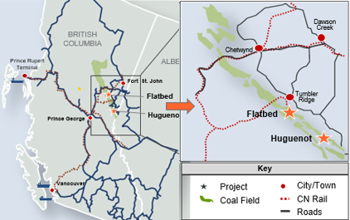
Investment Highlights
Unparalleled Investment Opportunity
Well-positioned to support projected global steel growth
  Global metallurgical supply of coal has faced constraints due to limited new mine developments, coinciding with increasing capacities of blast furnaces in key markets such as India and other Asian countries. This raises the potential for a medium-term supply deficit.
  As existing operations mature, higher strip ratios are anticipated, with associated increases in mining costs. Australia also faces the challenge of increasingly unfavorable royalty regimes. In contrast, western Canadian coal developers, with their stable regulatory environments, premium product quality, and strong ESG credentials, are well-positioned to capitalize on growing demand in global markets, with few viable alternatives available outside of Canada.
  Coal from CCIC's projects into East Asian markets offers advantages in costs and logistics.
Gain exposure to one of the most active coal belts in a mining-friendly jurisdiction with excellent infrastructure in place.
  Recent M&A & JV activity by Walter Energy, Anglo American (PRC), Glencore (via Xstrata), JX Nippon, Conuma in NEBC, plus Glencore & Bathurst in SEBC and Hancock in SW Alberta
  Capacity expanded at western Canadian coal ports
Project Location Map
Strategic location, 100% owned metallurgical coal properties adjacent to other major projects provide logical buyer and partnership opportunities
  Huguenot is located between Belcourt and Saxon projects owned by Peace River (PRC)
  Flatbed borders PRC’s Trend mine (currently under care and maintenance) and the proposed Windy-Window o/p mine (initially Teck, now Conuma),
  and lies close to HD Mining’s advanced Murray River u/g project.
Company Overview
Investment in two of the largest deposits of premium quality hard coking coal in western Canada
  The only Canadian-listed, publicly-traded, pure-play metallurgical coal company in western Canada: 100% interest in two resource-stage coal projects: Huguenot and Flatbed, located in the Peace River Coalfield of northeastern British Columbia.
  Huguenot Project: surface and underground mineable resources totaling approximately 277.7 million tonnes of Measured and Indicated resources, alongside 119.2 million tonnes of Inferred resources.
  The Gordon Creek Project (Flatbed property): contains approximately 298 million tonnes of inferred underground mineable resources.
Highly experienced management team with a proven track record in the Peace River Coalfield
  Highly capable management team with significant experience advancing other development projects in the region to production
  David Austin (President, CEO & Chairman) co-founded and built Western Coal Corp., sold to Walter Energy in 2010 for CAD$3.3 billion, and is credited for the exploration, development, and sale of Northern Energy & Mining Inc. (NEMI) to Anglo for ~ CAD$800 million

Slide 4
Western Canadian Coal Miners are Poised to Supply Asian Markets
Market Overview: Metallurgical Coal
BC Metallurgical Coal Production (Mt)
Western Canadian Coal Overview
Current pricing at US$180/t reflects a temporary downturn, although medium-term fundamentals remain strong. Globally, many operations are dealing with higher strip ratios, and in Australia, unfavorable royalty regimes are eroding competitiveness. Against this backdrop, Canada’s stable jurisdiction, strong ESG credentials, and premium product quality position our operations to capture sustained value and enhance market share as supply tightens and demand from key Asian markets, particularly India, continues to grow.
The region enjoys access to low-cost green power, high-quality road and rail networks, and major deep-water seaports.
British Columbia provides the closest ports on the west coast of North America to eastern Asia, leading to reduced shipping costs.
Since 2010, there have been significant merger and acquisition activities relating to metallurgical coal mines and development projects in western Canada.
10-Year Average = 28.4 Mt/y
Buyer | Target | Value
Walter Energy | Western Coal | CAD$3.3 B
Anglo American | NEMI Northern Energy Mines Inc. | ~CAD$800 M
Glencore | First Coal and Lossan | US$193 M
Winsway / Marubeni | Grande Cache Coal | CAD$1.0 B
Glencore¹ | Talisman’s Sukunka Proj. | US$500 M
JX Nippon | 25% of Glencore’s¹ BC coal assets | US$435 M
SonicField (CST Coal) | Winsway / Marubeni | US$475 M
Conuma | Quintette (Teck) | ~US120 M + ongoing 25% NP Royalty Interest
Hancock Prospecting | Riversdale Resources | AUS$737 M
Glencore | Teck Coal’s BC coal assets | US$9.0B
Access to East Asian Markets
To Shanghai – 4,642 miles
To Tokyo – 3,830 miles
Tianjin
Dalian
14.2
14.8
13.8
14.4
British
Columbia
Shanghai
Tokyo
Prince Rupert
13.2
14.2
10.6
11.9
To Shanghai – 5,092 miles
To Tokyo – 4,280 miles
Vancouver
Kolkata
Japan
23.1
24.3
Korea
Closer to Japan than Newcastle:
Newcastle to Tokyo – 4,284 miles
China
Kobe
India
Pusan
11.3
12.6
Guangzhou
12.7
13.0
00.0
Shipping Days from Prince Rupert
Mumbai
15.0
16.3
Hong Kong
25.2
26.4
Chennai
14.8
16.0
00.0
Shipping Days from Vancouver
22.8
24.0
Source: AME, BC Ministry of Energy, Mines and Petroleum Resources
Note: Shipping Days calculated at vessel speed of 15 knots
Note: Met coal includes all coals directed to metallurgical end markets (i.e. coking coals and PCI coals)
¹ At the time Xstrata

Slide 5
Management Team and Board of Directors
David Austin Chairman, President & CEO | Co-founder of Colonial Coal Corp., Western Coal Corp. (WCC), and Northern Energy & Mining Inc. (NEMI) One of the three founders credited for the success on the production of WCC projects (WCC was sold CAD$3.3 billion to Walter Energy in 2010) Credited for the success on the exploration/development and sale of NEMI to Anglo (for +CAD$400mm)
Ke Feng (Andrea) Yuan CFO | Chartered Professional Accountant (CPA) and Certified General Accountant (CGA) Canada since 2005 Certified Public Accountant (New Hampshire, USA) since 2007 Bachelor of Economics – Shanghai University of Finance & Economics Over 10 years experience as CFO of junior public companies listed on the TSX-V, CSE, and with OTC companies
John Perry COO & Director | 45 years as a professional geologist in exploration and development of coal & mineral projects (domestic and int’l.) Occupied senior corporate & exploration management roles for many coal projects in northeast British Columbia Former Director of Exploration - Belcourt Saxon Coal Limited Partnership 2005-2008 Former Manager of Exploration - Northern Energy and Mining Inc. (NEMI) 2004-2005
Partha S. Bhattacharyya Director | Director - Deepak Fertilizers and Petrochem. Corp. Ltd. & Haldia Petrochem. Ltd. 2016-Present Former Chairman & Managing Director - Coal India Limited 2006-2011 Former Chairman & Managing Director - Bharat Coking Coal Ltd. (BCCL) 2003-2006 Fellow - the Institute of Cost and Works Accountants of India & of the World Academy of Productivity Science
Ian Downie Director | Professional negotiator with an established mediation and dispute resolution consulting company Former Director of Terminal Operations - BC Ferry Corporation 1999-2007 Former Director - Cranbrook Credit Union & the Credit Union Deposit Insurance Corp. Former Commissioner – the Financial Institution Commission
Greg Waller Director | Retired in 2017 as Senior Vice President Investor Relations & Strategic Analysis - Teck Resources (the world's second largest, & North America's largest, steelmaking coal producer) Extensive knowledge of various commodity markets, industry participants and significant global mining assets Involved with major strategic decisions as leading spokesperson & member of the Teck’s senior management team

Slide 6
Western Canada Met Coal Project Comparison
In mid-2019, Hancock Prospecting Pty Ltd announced that it had acquired all of the outstanding ordinary shares of Riversdale Resources Limited that it did not already own
Implies a TEV of AUS$737 million for Riversdale (100.0% basis)
Riversdale's primary asset is the Grassy Mountain coking coal project, which is within the Crowsnest Pass Coalfield and is located in the province of Alberta
 | Grassy Mountain | Huguenot |  | Gordon Creek (Flatbed)
Project Description
Stage | Fed. Env. Review - Permitting | PEA |  | PEA
Location | Southwest Alberta | Northeast BC |  | Northeast BC
Coal Type | HCC | HCC |  | HCC & PCI
Total Resource | 195 Mt | 278 Mt (Measured + Indicated) and 119 Mt (Inferred) |  | 298 Mt (Inferred)
Acquisition Offer / Total Resource | AUS$3.78 per tonne | • |  | •
Operating Metrics |  | Option 1 | Option 2
Mine Type | Surface | Surface Only | Surface & UG | UG
Mine Life | 24 years | 27 years | 31 years | 30 years
Strip Ratio | 9.2:1 | 10.5:1 | 8.6:1 | -
LOM ROM Coal Production | 154 Mt | 99 Mt | 122 Mt | 112 Mt
LOM Clean Coal Production | 88 Mt | 72 Mt | 89 Mt | 57 Mt
LOM Avg. Annual Clean Coal Production | 3.7 Mt | 2.7 Mt | 3.0 Mt (Surface + UG) | 1.9 Mt
LOM Avg. Yield | 57% | 73% | 73% | 51%
Costs
Total FOB Cost | US$96/clean tonne¹ | US$110.38/clean tonne ^{2,3} | US$106.96/clean tonne ⁴ | US$80.91/clean tonne ⁵
Initial Capital Cost | US$488 M | US$303 M ^{2, 3} | US$661 M ⁴ | US$300 M ⁵
Notes: | ¹ From other sources | ² Option for Leased Surface Mining Equipment | ⁴ Exchange Rate Used: US$1.00 = CAD$1.30 | ⁵ Exchange Rate Used: US$1.00 = CAD$1.30
 |  | ³ Exchange Rate Used: US$1.00 = CAD$1.316
Note: HCC : Hard Coking Coal PCI : Pulverized Coal Injection

Slide 7
Colonial’s Projects: Two of the Largest Hard Coking Coal Deposits in the Region
Company Overview: Colonial Coal
  Huguenot has a contained resource of 277.7 million tonnes of combined Measured and Indicated resources plus 119.2 million tonnes of Inferred resources, making it one of the largest deposits in the region
  The Gordon Creek deposit on the Flatbed property has a contained resource of 298 million tonnes of inferred resources
  Coals from both Huguenot and Flatbed rank as premium metallurgical coking coals， The coals are amenable to washing to a low-ash product with low sulfur and low phosphorus
  Premium coking coal: the quality of coal at Huguenot and Flatbed is comparable to that once produced from the Quintette (Denison Mines/Teck) and Bullmoose (Teck) mines, and to coal more recently mined at the Anglo American’s Trend Mine, that is currently under care and maintenance. Coal from these mines, together with coal from Conuma’s Perry Creek Mine, has been exported to Asian markets for a long time. From 1984 to 2003, well over 100 million tonnes were exported to Japan from the Quintette and Bullmoose operations.
 | HUGUENOT |  |  |  | FLATBED
 | North Block | Middle Block | South Block | Total
Surface Mineable Resources
Measured + Indicated (MT) | 66.2 | 46.9 | 18.8 | 132.0
Inferred (MT) | 0.0 | 0.5 | 0.0 | 0.5
Underground Mineable Resources |  |  |  |  | Underground Mineable Resources Gordon Creek Deposit Area
Measured + Indicated (MT) | 37.6 | 31.2 | 77.0 | 145.7
Inferred (MT) | 86.8 | 1.6 | 30.2 | 118.7 | 298.0
TOTAL Mineable Resources
Measured + Indicated (MT) | 103.8 | 78.1 | 95.8 | 277.7
Inferred (MT) | 86.8 | 2.1 | 30.2 | 119.2 | 298.0

Slide 8
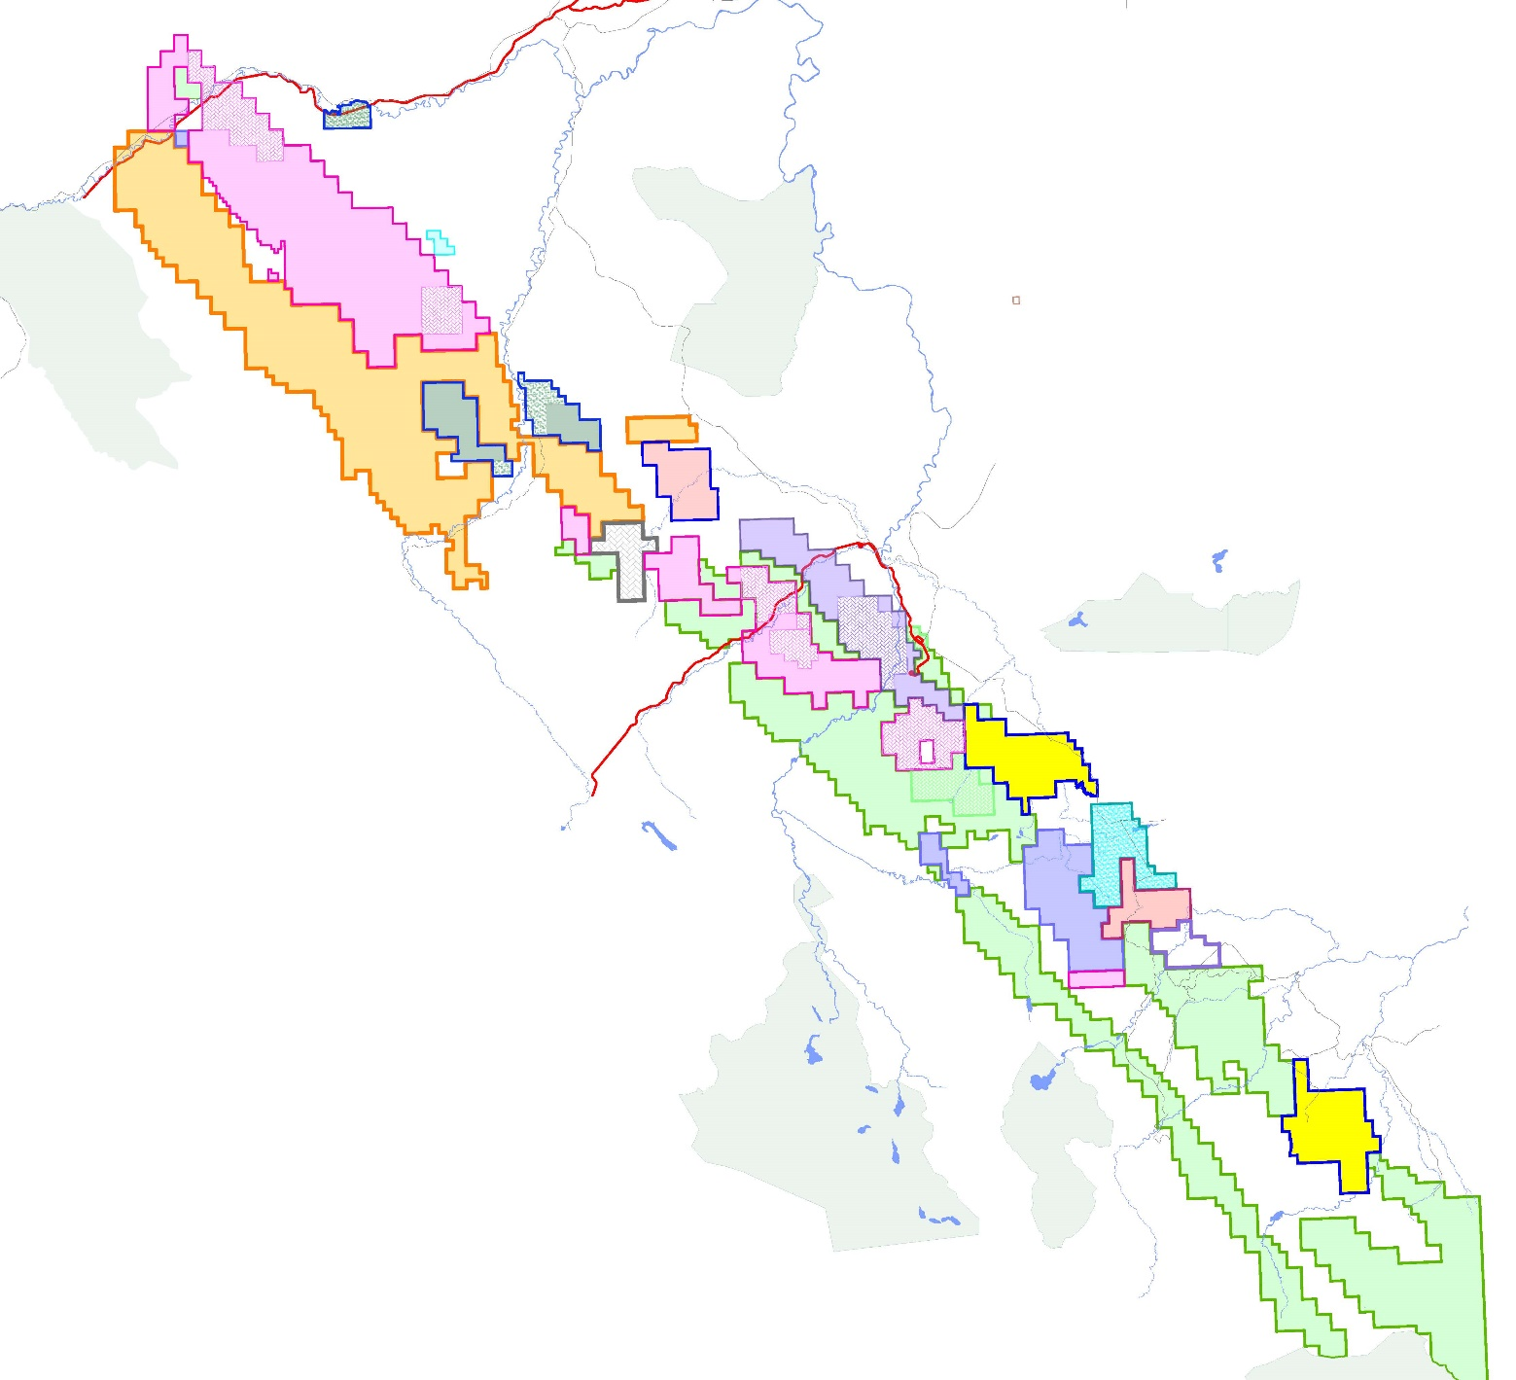
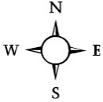



Peace River Coal Tenures
WILLOW CREEK (Producing)
Reserves: 6.6 Mt
Production (2024): 1.3 Mt
HUDETTE (EA Application)
Reserves: 15.6 Mt
BRULE
(Care & Maintenance)
Production (2024): 1.3 Mt
WOLVERINE :
PERRY CREEK (Mine Closure & Remediation)
Production (2024): 0.7 Mt
HERMANN (Permitting)
Resources: 24 Mt
Target Production: 1.0 Mtpa
Est. Mine Life: 10 Years
QUINTETTE –
MT. BABCOCK (Producing)
Re-start (in Q2 2025)
Production (2024): 0.2 Mt
Reserves: 36 Mt
Target Production: 3 - 4 Mtpa
Est. Mine Life: 10-12 Years
WILLOW CRK.
Chetwynd
CTI UA
CN Rail
SUSKA
Resource Definition
Resources: 103 Mt
SUKUNKA
Resources: 145 Mt
HD Mining Int’l. Ltd.
MURRAY RIVER
Approved Mine Permit
Projected Resources: 688 Mt
Target Production: 6 Mtpa
SUSKA
Conuma
NNW
UA
HUDETTE
FLATBED
Gordon Creek
PEA
Resources: 298 Mt (Inferred)
Product Tonnes: 57.4 Mt
Target Production: 1.6 - 2.6 Mtpa
Est. Mine Life: 30 Years
HUGUENOT
PEA
Resources
277.7 Mt (M+Ind) + 119.2 Mt (Inf)
Product Tonnes
Open Pit : 72 Mt
Underground : 50 Mt
Target Production
Open Pit : 2.7 Mtpa
Underground : 1.8 Mtpa
Est. Mine Life: 27-31 Years
Colonial Coal Corp.
CTI UA
Canadian Bullmoose Mines
FLATBED
Gordon Creek
BRULE
Glencore
CTI
Glencore
PERRY CREEK
MURRAY RIVER
CTI UA
Tumbler
Ridge
1010 Mines Corp.
HERMANN
BULLMOOSE
(Teck)
UA
Wapiti Coking
Coal Mines
WAPITI
Resources:
330 Mt
QUINTETTE
PRC
CN Rail
PEACE RIVER COAL
(CONUMA)
TREND & ROMAN
Care & Maintenance
Clean Coal Reserves : 34.1 Mt
Resources : 35.6 Mt
Target Production : 3.0 Mtpa
BELCOURT
Feasibility Level
Clean Coal Reserves : 57 Mt
Resources : 171.2 Mt
Target Production : 4 Mtpa
SAXON
Historical Feasibility
Historical “Reserves” : 76 Mt
TREND & ROMAN
EVR
Pioneer
ELK VALLEY RESOURCES
(GLENCORE)
MT. DUKE
Historical Feasibility
Historical “Resources”: 251.5 Mt
UA
PRC
NOTE:
UA – Under Application
HUGUENOT
BELCOURT
SAXON
PRC
Scale
0
20 km
NEBC-B-CL-20231003-PP.dwg cvs b3.jpg

Slide 9
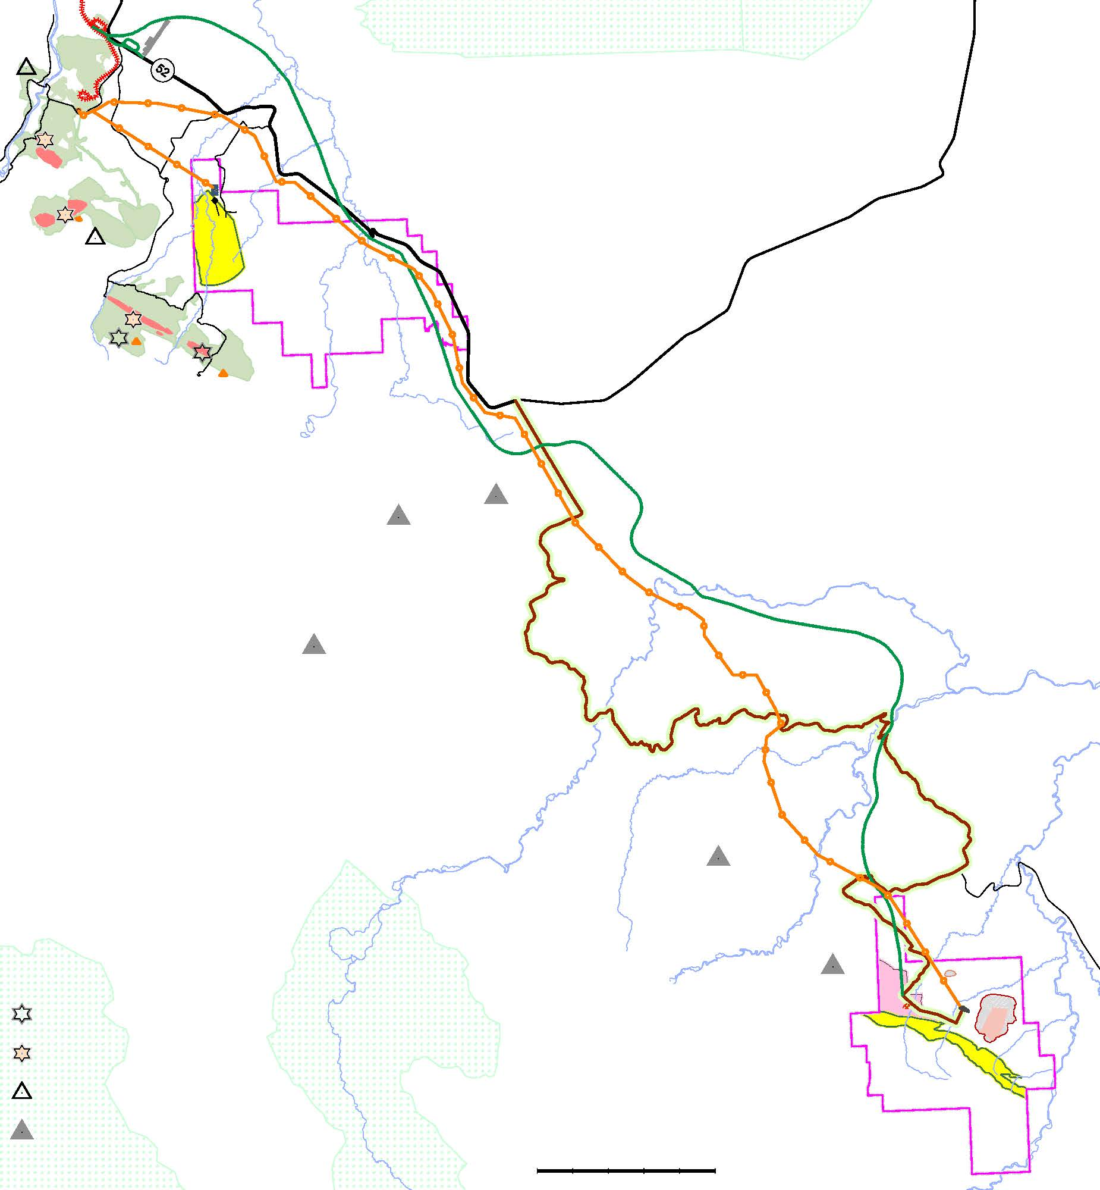
Conceptual Infrastructure Development Plan Highlights
Colonial Projects Overview:
  HUGUENOT
  2018 PEA considers the construction of an 85 km rail spur connecting the project to the main rail line, assumed to be built by a third party for use by Colonial and other potential Customers. Cost may be reduced by constructing an overland conveyor to replace the southern portion of the proposed rail line
  2020 PEA considers trucking to the existing rail line via upgraded off-highway roads (~75 km) and existing paved highway (~36 km).
  FLATBED
  2018 PEA considers 16 km of trucking (8 km of upgraded, off-highway road & 8 km of paved highway) to an independent loadout connected to the main rail line by a 1.8 km spur line.
PRC
Rail Loadout
Airstrip
Possible Flatbed
Rail Loadout
Murray River
Loadout Area
Paved Highway (36 km)
Quintette
Plant Site &
Loadout
Quintette
Sub-Station
To Dawson Creek
All Weather Road Joins Highway 52
Heritage Highway
Trend Mine Haul Road
Gordon Crk.
Area
Proposed Rail Line
Duke Mtn.
Wapiti
River
Proposed Power Line
≈ 78 km
FLATBED
  POTENTIAL FOR JOINT DEVELOPMENT
  Collaborating with other operators on joint infrastructure projects, such as roads, rail, and power lines, would reduce initial capital costs at Huguenot and Flatbed
  Huguenot is located next to the Belcourt Project (PRC) with the Duke Mountain (Glencore) and Wapiti (Wapiti Resources) properties located nearby, along the proposed transportation route
  Development and operating costs could be shared among all operators in the region for greater scalability and lower per tonne costs.
  While rail is the preferred mode of transportation in the region, trucking coal is also viable (as confirmed by past and current operations), although more expensive on a per tonne basis.
Wapiti River
See page 16
Onion Lake
All Weather Gravel Rd.
Upgraded FSR ≈ 75 km
Belcourt North
(Red deer)
Crk.
Red Deer
See page 10
Existing Coal Mines (Producing, Care & Maintenance)
Belcourt South
(Holtslander)
Past producers
HUGUENOT
Advanced Mine Development Projects
Proposed Pit
Regional Coal Deposits
0
10 km
Wapiti Park

Slide 10
Colonial Projects Overview:
HUGUENOT

Slide 11
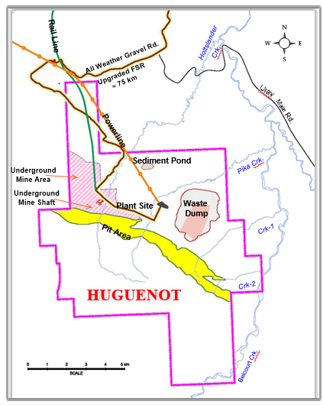
HUGUENOT PROPERTY
Company Overview: Colonial Coal
Situated adjacent to and contiguous with the proposed Belcourt South open pit (owned by PRC)
Trucking distance of ~111 km road– also accessible by ~85 km rail spur (or combination rail and overland conveyor) - to link with the existing rail line
Amenable to surface and underground mining
1.5 royalty on FOB sale price
Gates Formation coal seams: the same geological formation as mined by past and current producers in the Tumbler Ridge area
2018 PEA is based on an original study conducted in 2013 and updated in 2018, using then-current scoping-level cost estimates and economic analyses. It contemplates the construction of an 85 km rail spur, built by a third party, which would be accessible to other potential producers in the region. This rail spur would connect the project to the main rail line; however, the distance may be shorter if an overland conveyor is utilized.
  2020 PEA contemplates trucking to the existing rail line via upgraded off-highway roads (~75 km) and existing paved highway (~36 km)
  The mining studies conducted in 2013 and 2018 examined a combination of open-pit and underground methods.
  During the 2018 update, an opportunity was recognized to expand the open pit by increasing the stripping ratio, resulting in higher recoverable tonnages of mineable coal. This prompted the 2020 study, which examined a stand-alone surface mining option in a new PEA.
  Each PEA contemplates a 78 km, 230 kilovolt power transmission line.

Slide 12
HUGUENOT PROPERTY
Company Overview: Colonial Coal
2020 PEA Highlights (Open Pit Only)
The 2020 study used previously reported surface mineable resources to develop a revised conceptual mine plan utilizing a stand-alone open pit mine.
A more detailed analysis of the open pit design and equipment selection was carried out, which yielded larger mineable open pit tonnage, longer mine life, and a lower cost mining operation.
Alternative means of product coal transportation were considered, which resulted in a revised plan to transport coal by conventional haul trucks from the mine to the existing rail line south of Tumbler Ridge, as opposed to the previous concept of direct rail transport from the mine.
The trucking concept has the advantage of lower capital costs, lower risk, and a shorter construction schedule than the rail option.
The capital expenditures are based on two scenarios.
assumes that all major mining equipment is purchased outright in the year it is needed for the mining operations, with subsequent replacements purchased as needed over the mine’s life.
assumes that the major mining equipment will be leased in the year in which it is needed for the mining operations. Subsequent replacement equipment will also be leased when required.
Huguenot Project
NPV (millions) at Varying Discount Rates with IRR
PEA 2020 Coal Price/Tonne | PURCHASED EQUIPMENT SCENARIO
 | 5% | 7.5% | 10% | IRR%
US$174 | $1,482 | $1,027 | $718 | 26.30%
CAD$224 | $1,949 | $1,351 | $944 | 26.30%
PEA 2020 Coal Price/Tonne | LEASED EQUIPMENT SCENARIO
 | 5% | 7.5% | 10% | IRR%
US$174 | $1,474 | $1,032 | $732 | 29.40%
CAD$224 | $1,939 | $1,357 | $963 | 29.40%
** All costs are in US dollars, but where Canadian dollar equivalents are provided, they were converted using an exchange rate of US$1.00 equals CAD$1.316
In the purchased equipment scenario, the financial analysis suggests that coal prices required to achieve zero NPVs at discount rates of 5%, 7.5%, and 10% are approximately US$113, US$120, and US$125 per tonne, respectively. A coal price of US$137 per tonne is required for an IRR of 15%.
Based on the leased equipment scenario, the financial analysis suggests that coal prices required to achieve zero NPVs at discount rates of 5%, 7.5%, and 10% are approximately US$114, US$119, and US$125 per tonne, respectively. A coal price of US$137 per tonne is required for an IRR of 15%.

Slide 13
HUGUENOT PROPERTY
Company Overview: Colonial Coal
2020 PEA Highlights (Open Pit Only)
Measured and Indicated surface mineable coal resources total 132.0 million tonnes, with an additional Inferred resource of 0.5 million tonnes. Not included for mining in the 2020 PEA are in-situ underground mineable resources totaling 145.7 million tonnes (Measured and Indicated) and 118.7 million tonnes classified as Inferred
The 2020 PEA is based on a conceptual open pit mine plan targeting 99 million run-of-mine (“ROM”) tonnes of resource at an overall stripping ratio of 10.5:1 (bank cubic metres (bcm):ROM tonnes), yielding 72 million tonnes of product coal over a mine life of 27 years. The previous PEAs identified a smaller open pit with ROM tonnage of 56 million tonnes at a stripping ratio of 8.6:1, that yielded 39 million tonnes of product coal over 13 years.
Projected clean coal production from open pit mining operations ranges from 0.7 million tonnes per annum (“Mt/a”) to 3.0 Mt/a, averaging approximately 2.7 Mt/a.
Potential coal production is identified as hard coking coal similar to coking coal currently exported from northeast British Columbia.
The stand-alone open pit cash operating costs for the purchased equipment scenario are estimated at US$55.08 per tonne of product coal at the mine gate. The cash operating costs for the leased equipment scenario are estimated at US$61.47 per tonne.
Pre-production capital cost for the proposed mine in the purchased equipment scenario is estimated at US$510 million, with additional sustaining capital of US$215 million over the life-of-mine (LOM). Pre-production capital cost in the leased equipment scenario is estimated at US$303 million, with additional sustaining capital of US$42 million over the LOM.
The Huguenot Project’s proposed payback of initial capital is estimated within four years from start-up of operations for both scenarios.
The FOB cost for the purchased equipment scenario is estimated at US$104.14 (CAD$137.05) per clean tonne. The FOB cost for the leased equipment scenario is estimated at US$110.38 (CAD$145.26) per clean tonne.

Slide 14
HUGUENOT PROPERTY
Colonial Projects Overview:
2018 PEA Highlights (Open Pit and Underground Mine)
The 2018 PEA has an indicative after-tax (and royalty) net present value (NPV) of US$1,166 million (CAD$1,516 million) using a 7.5% discount rate, and an internal rate of return (IRR) of 33%, based on a coking coal price of US$172.0 per tonne.
The 2018 study is based on conceptual open pit and underground mine plans that target 122.3 million run-of-mine (ROM) tonnes of resource, with a yield of 73%, producing 89.3 million tonnes of clean coal over a mine life of 31 years.
PEA 2018 Coal Price/Tonne | Huguenot Project NPV (millions) at Varying Discount Rates with IRR
 | 5% | 7.5% | 10% | IRR%
US$172 | $1,669 | $1,166 | $831 | 33%
CAD$224 | $2,170 | $1,516 | $1,080 | 33%
* The exchange rate used in this report is US$1.00 equals CAD$1.30
The conceptual open pit mine plan targets 56 million ROM tonnes at an average stripping ratio of 8.6 :1 (bank cubic metres: ROM tonnes) while the conceptual underground mine plan targets an additional 66 million ROM tonnes.
The open pit operates during Years 1 - 14 while the underground mine would operate during Years 3 - 31, with both the open pit and underground mine operating simultaneously during Years 3 - 14.
Measured and Indicated coal resources total 277.7 million tonnes (132.0 million tonnes surface plus 145.7 million tonnes underground).
Inferred resources total an additional 119.2 million tonnes (0.5 million tonnes of surface plus 118.7 million tonnes underground).
In full mine operation, projected clean coal production from the combined surface and underground mining operations ranges from 1.4 to 5.9 Mtpa, and averages approximately 3.0 Mtpa.
The pre-production capital cost for the proposed surface (leased equipment) and underground (purchased equipment) mines is estimated at US$661 million, with additional sustaining capital of US$178 million over the life-of-mine (LOM).
The proposed payback of initial capital is estimated within 5 years from start-up of operations.
The Huguenot Project’s FOB cost is estimated at US$106.96 (CAD$139.05) per clean coal tonne.
This includes direct mine site costs of US$67.20 per tonne, offsite costs (transportation and port charges) of US$28.30 per tonne and indirect costs of US$11.46 per tonne.

Slide 15
Colonial Projects Overview:
Huguenot Project Coal Quality Comparison
The Huguenot Project is projected to produce a clean premium hard coking coal (HCC) product with low ash, low sulfur, low phosphorus, and High FSI
Coal Quality Comparison:
Huguenot HCC VS. Canadian Export Coking Coals
 | Huguenot HCC¹ | Canadian NEBC HCC² | Canadian SEBC HCC²
Total Moisture (% as received) | 9 | 8 - 9 | 8
Volatile Matter (% air dry) | 22.5 - 23.5 | 23.0 - 24.5 | 21.0 - 27.0
Ash Content (% air dry) | 8.50 – 9.00 | 8.25 - 8.60 | 8.50 - 9.60
Sulphur Content (% air dry) | 0.40 | 0.45 - 0.55 | 0.35 - 0.75
Free Swelling Index (FSI) | 6.5 - 7 | 7 - 8 | 6 - 8
Mean Max Reflectance of Vitrinite (%) | 1.15 - 1.20 | 1.15 - 1.25 | 1.08 - 1.35
Maximum Fluidity (ddpm) | 100 | 150 - 300 | 40 - 300
Phosphorus in Coal (% dry) | 0.044 | 0.008 - 0.040 | 0.010 - 0.065
Base/Acid Ratio of Ash | 0.08 - 0.10 | 0.12 - 0.18 | 0.07 - 0.10
Coke Strength after Reaction (CSR) | 60 - 65 | 58 - 60 | 68 – 72
 |  | NEBC = Northeast British Columbia | SEBC = Southeast British Columbia
 | ¹ Results based on laboratory scale washing and testing of exploration samples. | ² Results based on full washing plant under operating conditions.
 | Data Source: Kobie Koornhof Associates Inc.

Slide 16
Company Overview: Colonial Coal
FLATBED

Slide 17
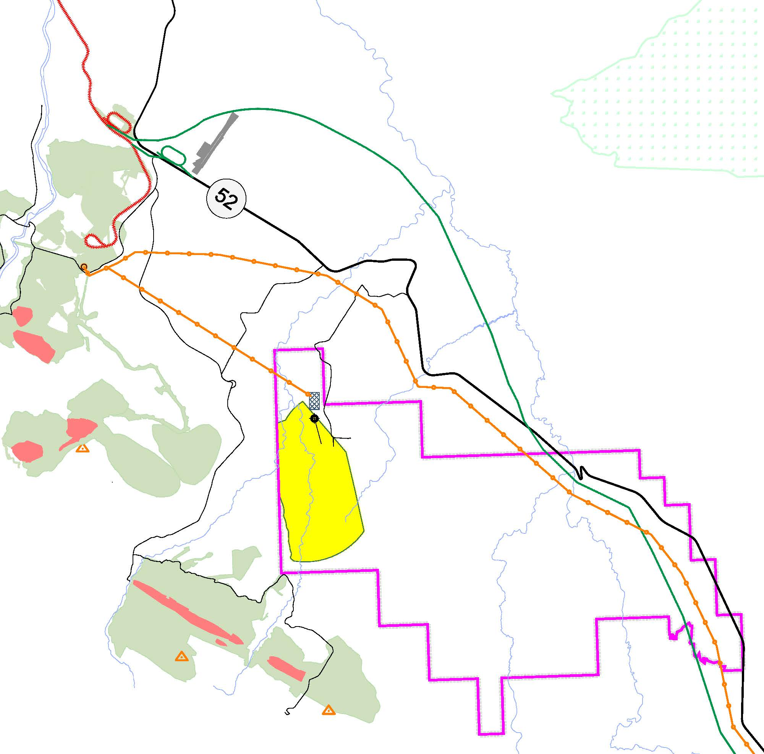

Colonial Projects Overview:
Gordon Creek Metallurgical Coal Project (Flatbed Property)
PROJECT SUMMARY
Proximal to supportive infrastructure such as existing rail, power, highways, and the town of Tumbler Ridge.
Located near currently and recently producing coal mines (with rail loadouts and wash plants), plus several other very advanced, permitted, coal projects.
Amenable to underground mining.
1.5% royalty on FOB port sale price.
Gates Formation coal seams: the same as past and current producers in the Tumbler Ridge area.
Hard Coking Coal (HCC) - Seams B to G plus Premium Pulverized Coal Injection (PCI) Coal - Seams J and K.
CN Rail
Rail Loadout
(Possible)
Flatbed Crk.
PRC
Rail Loadout
Airstrip
Proposed
Bearhole
Lake Park
MURRAY RIVER
Loadout Area
Rail Line
36 km.
QUINTETTE
Plant Site & Loadout
Sub-Station
Paved
Highway
to Huguenot
FLATBED
COAL PROPERTY
Lodge
Colonial Coal Corp.
Rd.
PD Road
527
Haul
Trend Mine
Proposed
Road
Core
Wash Plant
(Proposed)
Power Line
WINDY
Pit
Babcock Mtn.
to
U/G Portal & Decline
(Proposed)
Huguenot
WINDOW
(Proposed Pit Footprint)
Resource Area
(Gordon Creek)
ROMAN
Pit Area
Roman
Mtn.
Flatbed Crk.
TREND
Pits
Quintette
Mtn.

Slide 18
Colonial Projects Overview:
Gordon Creek Metallurgical Coal Project (Flatbed Property)
Gordon Creek Project (Flatbed) 2018 PEA Highlights
The Gordon Creek Project has an indicative after-tax (and royalty) NPV of US$691 million (CAD$898 million) using a 7.5% discount rate, and an IRR of 24.4%, based on a weighted average coking coal price of US$164.8 per tonne and a premium pulverized coal injection coal price of US$140.5 per tonne.
PEA 2018 Overall Average Coal Price/Tonne | Gordon Creek Project (Flatbed) NPV (millions) at Varying Discount Rates with IRR
 | 5% | 7.5% | 10% | IRR%
US$160.5 | $1,081 | $691 | $446 | 24.4%
CAD$208.7 | $1,405 | $898 | $579 | 24.4%
Note: The exchange rate used in this report is US$1.00 equals CAD$1.30
The PEA is based on a conceptual underground mine plan that targets 111.6 million ROM tonnes of resource, with a yield of 51%, producing 57.4 million tonnes of clean coal over a mine life of 30 years.
Geological modeling and resource estimation of the Gordon Creek deposit have identified an Inferred coal resource of 298 million tonnes.
In full mine operation, projected clean coal production ranges from 1.6 to 2.6 Mtpa, and averages approximately 1.9 Mtpa.
The pre-production capital cost for the underground mine is estimated at US$300 million, with additional sustaining capital of US$406 million over the LOM. The proposed payback of initial capital is estimated to be within three years from the start of coal production.
Gordon Creek’s FOB cost is estimated at US$80.91 (CAD$105.19) per clean coal tonne. This includes direct mine site costs of US$41.16 per tonne, offsite costs (transportation and port charges) of US$25.42 per tonne and indirect costs of US$14.33 per tonne.

Slide 19
Colonial Projects Overview:
Gordon Creek Metallurgical Coal Project (Flatbed Property)
Premium clean hard coking coal product (Seams B, D, F (combined F1 and F2), and Seam G, totalling 71.4% of the reported resources) plus a premium pulverized coal injection (PCI) product (Seams J and K, totalling 28.6% of the reported resources).
Coal Quality Comparison
Gordon Creek PCI Coal VS. Export PCI from Queensland/NEBC
 | Gordon Creek PCI Coal¹ |  | Low Vol PCI from QLD/NEBC²
 | Seam J | Seam K | Min | Max
Total Moisture (% as received) | 8.0 - 9.0 | 8.0 - 9.0 | 8.0 | 10.5
Volatile Matter (% air dry) | 18.5 | 18.2 | 9.5 | 20.4
Ash Content (% air dry) | 8.5 | 6.0 | 7.5 | 10.5
Sulphur Content (% air dry) | 0.37 | 0.41 | 0.28 | 0.70
Free Swelling Index (FSI) | 3.5 | 3.5 | 0 | 2
Hardgrove Grindability Index (HGI) | 80 | 79 | 65 | 90
Carbon Ultimate DAF % | 90 | 91 | 88 | 92
Hydrogen Ultimate DAF % | 4.2 | 4.2 | 3.6 | 4.9
Mean Max Reflectance of Vitrinite (%) | 1.43 | 1.43 | 1.26 | 1.75
Phosphorus in Coal (% dry) | 0.020 | 0.002 | 0.030 | 0.100
Calorific Value (Gross air dry) Kcal/kg | 7913 | 8138 | 7450 | 7910
Coke Replacement Ratio* | 0.92 | 0.93 | 0.87 | 0.93
Note: * = Calculated; QLD = Queensland; NEBC = Northeast British Columbia ¹ Results based on laboratory scale washing and testing of exploration samples. ² Results based on full washing plant under operating conditions. Data Source: Kobie Koornhof Associates Inc.
Gordon Creek Coking Coal VS. Canadian Export Coking Coals
 | Gordon Creek Coking Coal¹ |  | Canadian NEBC HCC² | Canadian SEBC HCC²
 | Min | Max
Total Moisture (% as received) | 8 | 9 | 8 - 9 | 8
Volatile Matter (% air dry) | 20.7 | 25.2 | 23.0 - 24.5 | 21.0 - 27.0
Ash Content (% air dry) | 8.00 | 8.90 | 8.25 - 8.60 | 8.50 - 9.60
Sulphur Content (% air dry) | 0.44 | 0.90 | 0.45 - 0.55 | 0.35 - 0.75
Free Swelling Index (FSI) | 6 | 8 | 7 - 8 | 6 - 8
Mean Max Reflectance of Vitrinite (%) | 1.18 | 1.39 | 1.15 - 1.25 | 1.08 - 1.35
Maximum Fluidity (ddpm) | 12 | 1135 | 150 - 300 | 40 - 300
Phosphorus in Coal (% dry) | 0.049 | 0.089 | 0.008 - 0.040 | 0.010 - 0.065
Base/Acid Ratio of Ash | 0.08 | 0.22 | 0.12 - 0.18 | 0.07 - 0.10
Coke Strength after Reaction (CSR) | 51* | 70* | 58 - 60 | 68 - 72
Note: * = Calculated; NEBC = Northeast British Columbia; SEBC = Southeast British Columbia ¹ Results based on laboratory scale washing and testing of exploration samples. ² Results based on full washing plant under operating conditions. Data Source: Kobie Koornhof Associates Inc.

Slide 20
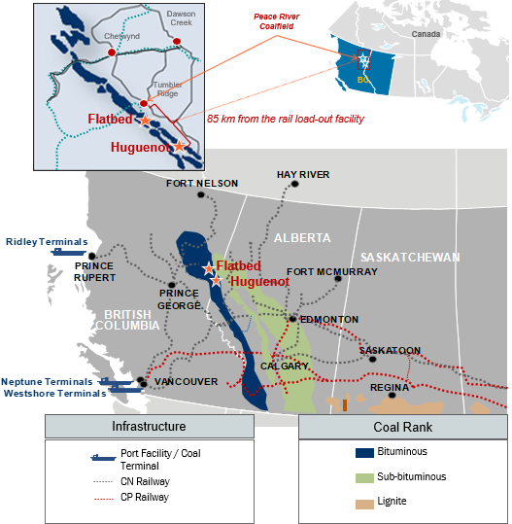
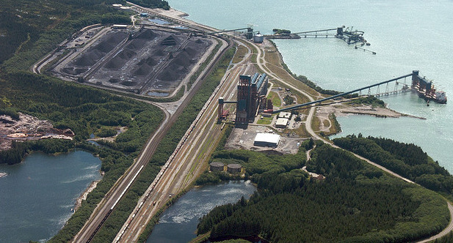









Access to World Class Infrastructure
Production from Huguenot and Flatbed would be shipped by rail to one of the three export terminals on the west coast of British Columbia.
Access to deep water export terminals, including the Neptune and Westshore terminals in Vancouver and the Ridley Terminal in Prince Rupert, B.C.
Rail lines out of the Peace River Coalfield are operated by a Class I Canadian carrier (CN Rail, the largest railway company in Canada) and have available capacity to support future production from Huguenot and Flatbed.
The project would use hydroelectric power, which is in line with carbon-neutral development goals. Under the pressure of increasing carbon emission tax, the economic advantages of the project will be more significant in the future.
RIDLEY TERMINAL IN PRINCE RUPERT, B.C.
Western Canadian Metallurgical Coal Companies

